Slide 1
Building Serverless Applications in Azure
Joe Raio
Microsoft Technical Evangelist
@joescars

Slide 2




Joe Raio
Senior Technical Evangelist
Commercial Software Engineering
joe.raio@microsoft.com
@joescars
github.com/joescars
Based in Miami, FL United States.
Proud father. Passions are Music, Space, Aviation & all things Technology
Notes:
What is a technical evangelist?

Slide 3
Agenda
Serverless @ Microsoft
Tooling Demos
What’s Next?
Resources
Notes:
Serverless offerings @ Microsoft
Azure Functions
Logic Apps
Event Grid
Tooling
Azure Portal
Azure Functions Core Tools CLI
Visual Studio (PCL)
MAC Preview
CI / CD
Application Insights
Roadmap / Features in Preview
Proxies
Durable Functions
Event Grid
API Versioning
.NET Core and Java Support
Resources
Open Source & Communication Methods

Slide 4
Serverless @ Microsoft

Slide 5
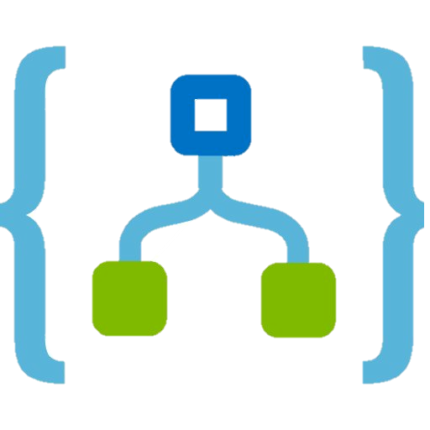


Serverless Components in Azure
Functions
Logic Apps
Event Grid
Serverless Compute
Serverless Workflows
Serverless Events

Slide 6


Serverless application platform components
Development
Platform
IDE support
Functions
Logic apps
Developer tooling
Bindings and triggers
Open source
Visual designer
125+ connectors
Functions orchestration
Visual debug history
Local development
Data/storage
Messaging
Gateway Connectors
Intelligence
Bots
Verbose debugging

Slide 7








Azure Functions
Serverless
Accelerate development
Bind into services
Azure Service Bus
Azure Event Hub
Azure Storage
</>
Dropbox
Sendgrid
AzureDocDb
Event-driven scale
Reduced Dev Ops
Develop your way
Local development
OneDrive
Box
Twilio
Notes:
Languages: C#, F#, Node.js, Python, PHP, batch, bash, R, Java, TypeScript

Slide 8

Azure Functions
Binds to many Azure Services
Blob Storage
Service Bus
Event Hub
CosmosDB (NoSQL) and more…
Supported Languages
Node.js
C#, F#, TypeScript
PHP, Batch
PowerShell and more…
https://aka.ms/TryAppService
Notes:
Azure Functions supports many more bindings, triggers and languages
Python, Batch, PHP, PowerShell

Slide 9
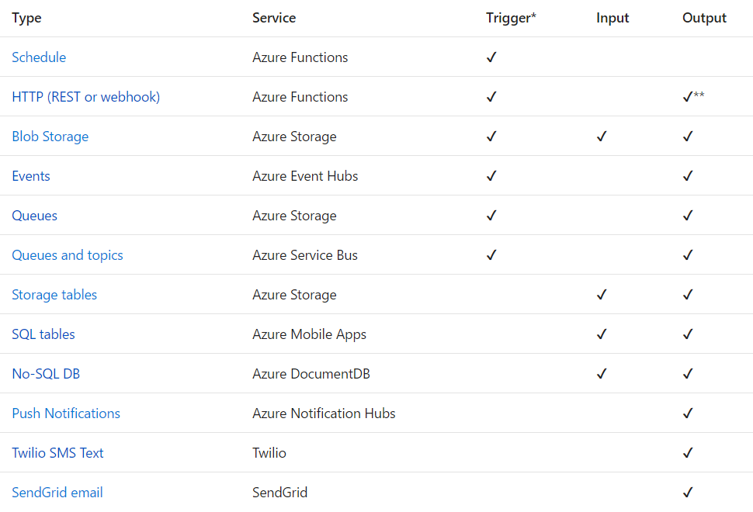
Triggers
and
Bindings
Notes:
The difference between trigger and binding…

Slide 10
Use Bindings in Your Code
Index.js
function.json
module.exports = function (context, myQueueItem, myOutputBlob) {
context.log('JavaScript queue trigger function ', myQueueItem);
//validate
if (myQueueItem.apiId && myQueueItem.method && myQueueItem.body)
{
const value = DoWork(myQueueItem);
if(value) {
context.bindings.myOutputBlob = JSON.stringify(value);
//myOutputBlob = JSON.stringify(value);
}
}
else {
//handle error queue item missing params
context.log('invalid queue item ', myQueueItem);
}
context.done();
}
{
"bindings": [
{
"name": "myQueueItem",
"type": "queueTrigger",
"direction": "in",
“queueName": "outputqueue",
"connection": "AzureWebJobsStorage"
},
{
"type": "blob",
"name": "outputBlob",
"path": "outblob/{rand-guid}.txt",
"connection": "AzureWebJobsStorage",
"direction": "out"
}
]
}
Notes:
Binding gives you access to the underlying api without having to use the SDK

Slide 11
Use Bindings in Your Code
run.csx
function.json
public static void Run(byte[] image, string filename,
Stream outputBlob, TraceWriter log)
{
log.Info($"Processing image: {filename}");
var imageBuilder = ImageResizer.ImageBuilder.Current;
imageBuilder.Build(
image, outputBlob,
new ResizeSettings(640, 400, FitMode.Max, null), false);
}
{
"bindings": [
{
"name": "image",
"type": "blobTrigger",
"direction": "in",
"path": "card-input/{filename}.jpg",
"connection": "AzureWebJobsStorage"
},
{
"type": "blob",
"name": "outputBlob",
"path": "card-output/{filename}.jpg",
"connection": "AzureWebJobsStorage",
"direction": "out"
}
]
}

Slide 12







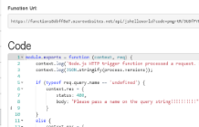





Example DevOps experience with Functions
1) Trigger
2) Input binding
3) Develop
4) Execute
5) Output binding
Web
Hooks
App Services
Hosting Plans
Azure Services
Azure Services
Azure Services
7) Develop locally
6) Monitor and improve
Notes:
This is the whole (top level) Dev Ops story where Dev build wounderful apps, using CI they mange their code, builds, and releases. Connecting to a repository, they can deploy to Azure Websites, build in the cloud, deploy to a slot to test and validate, swap into production, deployed across the globe as needed, monitor and get feedback, on which devs can make updates. Rinse and repeat

Slide 13
Introducing Azure Logic Apps
Powerful Integration and Workflow Engine born in Azure
Fast integrations using a visual designer and workflow creation with triggers and actions
Connect applications, data and services
Connect and orchestrate Azure Functions
Notes:
-Started with BizTalk server (in for 17 years) – how can we move things faster between enterprise integration? LogicApps was born out 100% out of Azure.
-how to reduce integration from weeks/months to days?

Slide 14
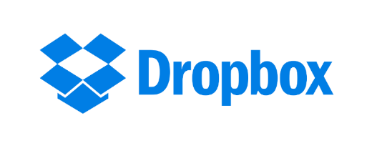





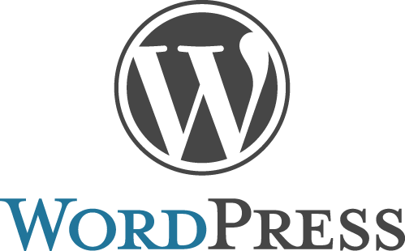


Logic apps connectors—Over 100 and growing
….and more!
Notes:
*Over 150 now?

Slide 15
Logic Apps
SaaS
Protocols/Native
appFigures
Asana
Azure API Management
Azure App Services
Azure Automation
Azure Cognitive Face API
Azure Cognitive LUIS
Azure Cognitive Text Analytics
Azure Cognitive Vision
Azure Data Lake Store
Azure Document DB
Azure Event Hub
Azure Functions
Azure Machine Learning
Azure Resource Manager
Azure Service Bus
Azure SQL
Azure Storage Blob
Azure Storage Queues
Basecamp
Bing Search
BitBucket
Bitly
Blogger
Box
Buffer
Campfire
Chatter
Common Data Service
Disqus
DocuSign
Dropbox
Dynamics AX Online
Dynamics CRM Online
Dynamics CRM Service Bus
Dynamics Financials
Dynamics Operations
Easy Redmine
Eventbrite
Facebook
FreshBooks
Freshdesk
GitHub
Gmail
Google Calendar
Google Contacts
Google Drive
Google Sheets
Google Tasks
GoTo Meeting
GoTo Training
GoTo Webinar
Harvest
HelloSign
Infusionsoft
JIRA
Insightly
Instagram
Instapaper
MailChimp
Mandrill
Medium
Microsoft Project Online
Microsoft Translator
MSN Weather
Muhimbi PDF
Office 365
Office 365 Users
Office 365 Video
OneDrive
OneDrive for Business
OneNote
Outlook.com
Outlook Tasks
PagerDuty
Pinterest
Pipedrive
Pivotal Tracker
Power BI
Project Online
Redmine
Salesforce
Salesforce Chatter
SendGrid
SharePoint Online
Slack
SmartSheet
SparkPost
Stripe
Survey Monkey
Todoist
Toodledo
Trello
Twilio
Twitter
Typeform
UserVoice
VS Team Services
Webmerge
Wordpress
Wunderlist
Yammer
YouTube
Zendesk
HTTP, HTTPS
HTTP Webhook
FTP, SFTP
SMTP
RSS
Compose, Query, Parse JSON
Wait
Terminate
Workflow
Cloud APIs and platform functionality
Over 120 built-in connectors
Hosted and managed within the platform
Scales to meet your needs
First class designer experience
Rapid development
XML and EDI
XML Validation
Transform XML (+Mapper)
Flat File Encode
Flat File Decode
X12
EDIFACT
AS2
Integration Account Artifact Lookup
API connections
Authenticate once and reuse
Differentiate connection configuration
Simple to deploy
Portal experience for managing API Connections
Hybrid
BizTalk Server
File System
IBM DB2
Informix
Oracle DB
SharePoint Server
SQL Server
SAP
Websphere MQ
Notes:
Call out that we now support stored procs on-prem

Slide 16



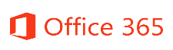






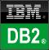

Logic Apps connects everything
Azure Functions
Service bus
Cognitive services
Logic Apps
Machine learning
On-premises data gateway
BizTalk server
Notes:
Logic Apps can integrate with “anything” (APIs) and solve small or complex problems. Automation in a secure and reliable environment fast and easy.
Connect Anything:
On-premises, hybrid and cloud
Mission critical, complex integration scenarios
Business productivity
Agile Business:
Quickly create workflows
Position to the future API centric
Transform Business:
Extract value from both (on-premises and cloud apps)
Build Holistic integration solutions.

Slide 17
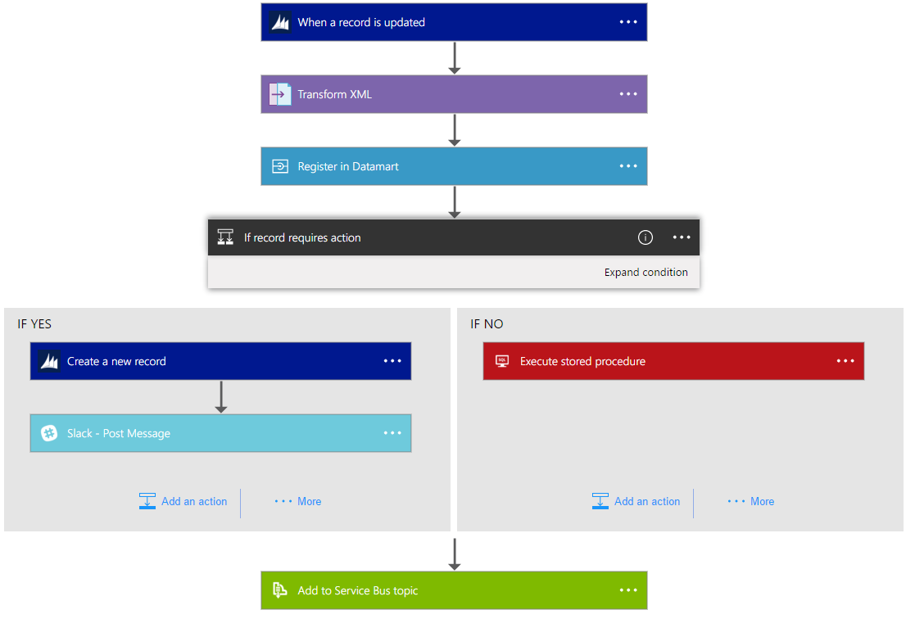
Logic Apps Workflow Designer
Workflow in the cloud
Powerful control flow
Connect disparate applications
No code designer for rapid creation
Also works within Visual Studio for added CI/CD

Slide 18
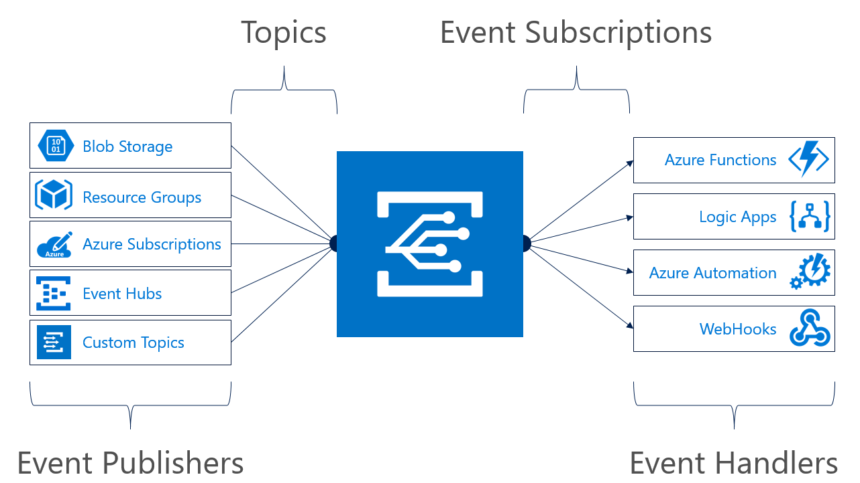
Azure Event Grid
Notes:
Event Grid - Azure Event Grid allows you to easily build applications with event-based architectures. You select the Azure resource you would like to subscribe to, and give the event handler or WebHook endpoint to send the event to. Event Grid has built-in support for events coming from Azure services, like storage blobs and resource groups. Event Grid also has custom support for application and third-party events, using custom topics and custom webhooks.

Slide 19

Demo: Building Serverless Applications

Slide 20
Tooling

Slide 21
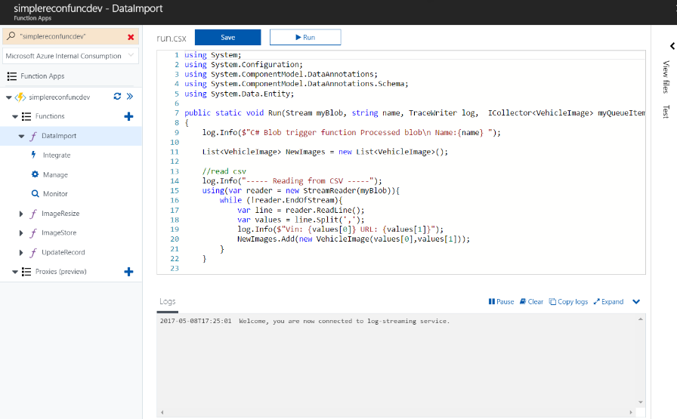
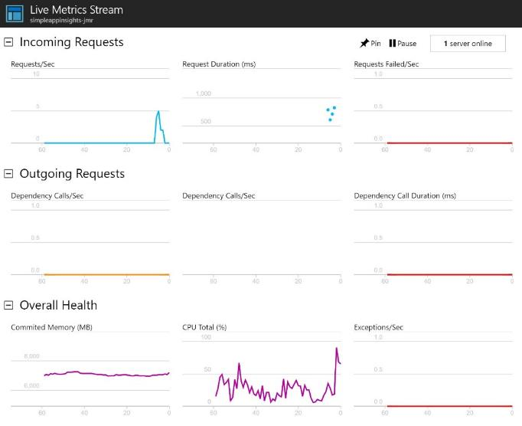
Azure Functions Portal
Code directly in the browser
Easily setup triggers & bindings
Live execution log
Manage secure application settings
Setup continuous deployment
Top down view of all functions
Monitor function execution history
Application Insights

Slide 22
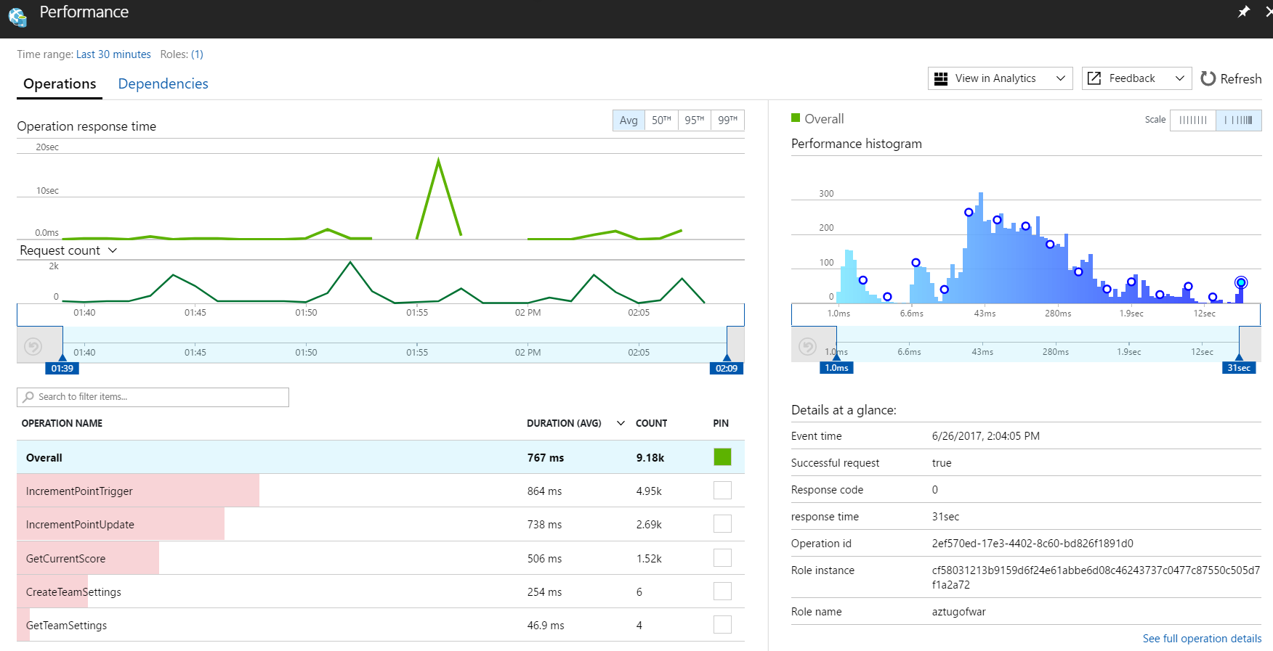
Application Insights

Slide 23
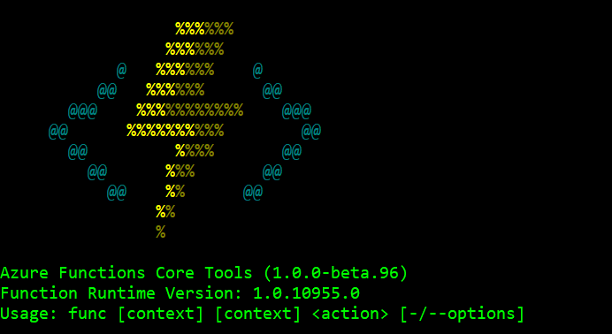
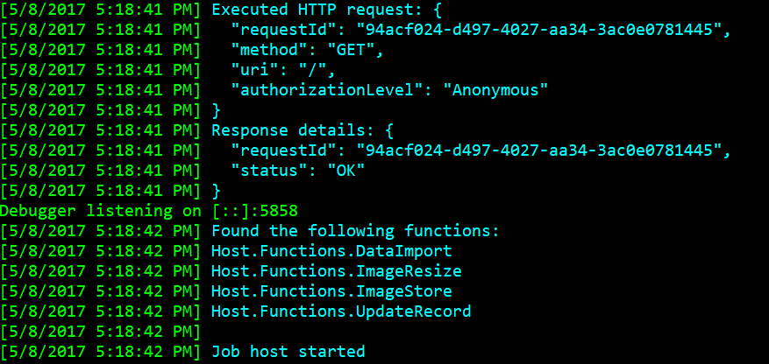
Azure Functions Core Tools – (CLI)
Run and Debug locally
Not an emulator or simulator!
Run the Functions runtime on your local machine
Functions invoked (triggered) based on events in Azure
Install via NPM Package: https://www.npmjs.com/package/azure-functions-core-tools
Create/ Developer/ Manage Azure Functions

Slide 24
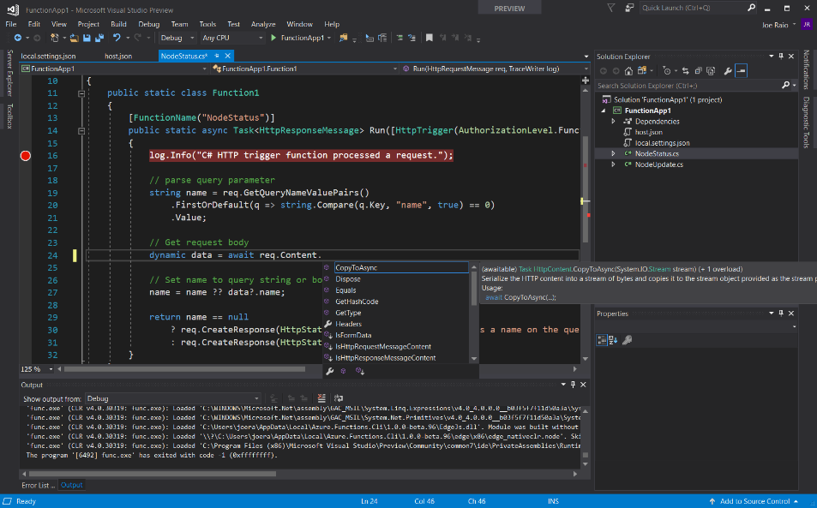
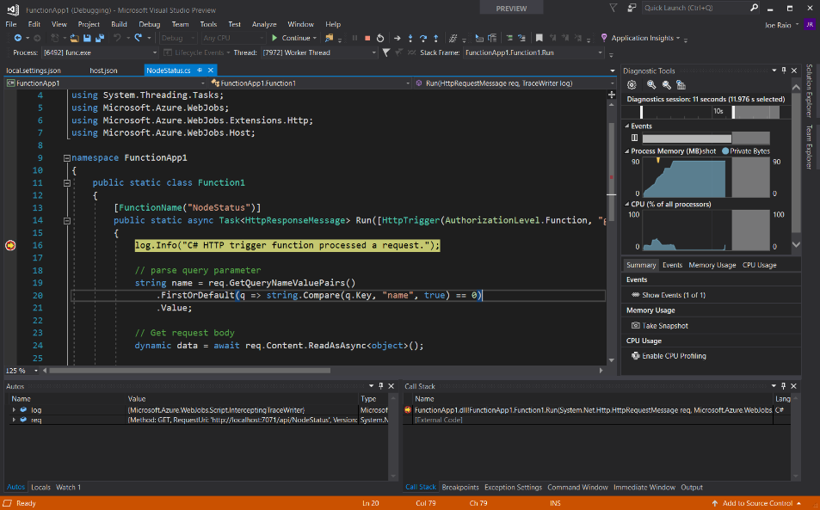
Visual Studio 2017
Full IntelliSense Experience
F5 Debugging
Develop in C# vs C# Script
Right-click deploy to Azure
Included in VS2017 15.3
https://aka.ms/2017functiontools
Pre-Compile functions for better cold start performance

Slide 25
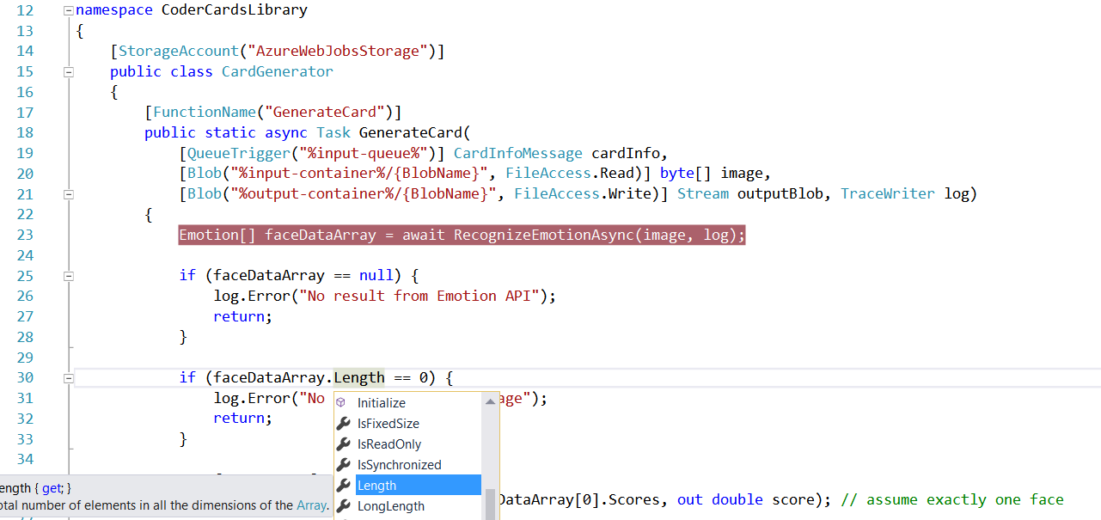
Visual Studio 2017 Tooling
Notes:
Uses binding attributes

Slide 26
What’s next?

Slide 27
Roadmap & Preview Features
Event Grid - https://aka.ms/azureeventgrid
Durable Functions - https://aka.ms/durablefunctions
API Versioning
.NET Core and Java Support
CLI Tools for MAC
Proxies
Notes:
Event Grid - Azure Event Grid allows you to easily build applications with event-based architectures. You select the Azure resource you would like to subscribe to, and give the event handler or WebHook endpoint to send the event to. Event Grid has built-in support for events coming from Azure services, like storage blobs and resource groups. Event Grid also has custom support for application and third-party events, using custom topics and custom webhooks.
Durable Functions – Alpha Preview - With Durable Functions, we let you write orchestrators and activities as Functions. Orchestrators can call Activity Functions and wait for an external event. Activity Functions can be written in any language and don’t have any restrictions on them that normal functions don’t have. Combined, this functionality allows a lot of complex patterns to be expressed via code.
API Versioning -

Slide 28
Summary

Slide 29
Build apps faster
Functions
Logic Apps
Consumption and provisioned options
Local development and advanced DevOps with detailed monitoring
Bindings to first and third-party services
Open source runtime
Rich portal visual designer and Visual Studio integration
Switch statements and loops
120+ connectors to SaaS and PaaS, with custom connector support
ARM template-based for easy reuse
Notes:
TIME MARKER: 11:20 A.M.

Slide 30
Increased developer productivity
Jump start your development
Build rich business apps
Pre-built templates
Integrate with PowerApps and CDS*
Automatic triggers
Integrate with Microsoft Flow*
Declarative bindings
Git/GitHub integration
Use existing development skills
Orchestrate workflows easily
Rich development tools
Graphical visual designer
IDE support for visual studio
Over 100+ connectors
F5 and visual debugging
Edit, author, visualize workflows easily
Verbose debugging
Quickly orchestrate multiple functions
Local SDK/runtime

Slide 31
Azure Functions is an Open Source project
https://github.com/Azure/Azure-Functions
Azure WebJobs SDK script - the Azure Functions runtime
Azure WebJobs SDK - the "core" of the Azure Functions runtime and many bindings
Azure WebJobs SDK extensions - the repositories of many bindings
Azure Functions CLI - the command line tool for Azure Functions
Azure Functions Portal - the UX for the Functions development portal
Azure Functions templates - the templates which show up the Azure Functions portal
Azure Functions samples - repository for some samples on how the runtime works

Slide 32
Azure Functions in Use
Costa Farms
http://aka.ms/costafarms
https://github.com/joescars/CostaIoTSensorProject
Fish Angler
http://aka.ms/fishangler
https://github.com/FishAngler/AzureFunctions
Simple Recon
https://github.com/simpledealersuite/media2azure
NullspaceVR
https://github.com/DaveVoyles/NullspaceVR-web-portal/tree/master/AzureFunctions
Missing Children Society of Canada
https://github.com/Missing-Children-Society-Canada

Slide 33

Azure offers a comprehensive Serverless Application Platform
Azure Functions Bindings and Local DevEx get you faster to market
Azure Logic Apps provides orchestration and integrations with 125+ APIs
Try Functions and Logic App https://aka.ms/TryAppService
Join the Azure Functions Community https://aka.ms/func-github

Slide 34
Questions?
Contact Information
Joe.Raio@Microsoft.com
twitter @joescars
joeraio.com
github.com/joescars
Download this presentation:
slideshare.net/joeraio

Slide 35
What is Serverless?

Slide 36
Serverless is to servers as wireless is to wired.
Wireless internet still requires wires, but customers don't need to interact with them
- Some smart person (not me)

Slide 37
The “evolution” of application platforms
On-Premises
IaaS
PaaS
Serverless
Notes:
FaaS – Functions as a Service

Slide 38
Serverless is …
$
Abstraction of servers
Event-driven/ instant scale
Micro-billing
Notes:
Abstraction of servers, infrastructure and configuration of operating system
Event-driven scale
Sub-second billing
Stateless
Serverless compute is a fully managed service. Some refer to it as Functions as a Service
OS and Framework patching is performed for you
There is zero administrative tasks and no need to manage any infrastructure
You just deploy your code (function) and it runs
Your code runs within seconds and for very short period of time
Serverless compute scales quickly (almost instantly) and vastly
Automatically scales within seconds
No scale configuration is required (there is no way to configure scale or limits)
Scales to match any given workload. Scales from zero to handle tens of thousands concurrent functions invocations within seconds
Pay only for the time your code is running
Serverless compute reacts to events
React, in near real-time, to events and triggers
Triggered by virtually any event from Azure service or 3rd party services
Setup time, provisioning is long & costly

Slide 39
Do more. Serverless.
DevOps Productivity
Focus on business logic
Faster time to market
Notes:
“Pinnacle of PaaS compute”
Not just hardware “servers”, but software servers are also managed for you
Focus on business logic, not solving technical problems not core to business
Lower effort to get started makes it easier to experiment (bots, etc.)
Benefits of “Serverless”

Slide 40
Serverless application platform components
Development
Platform
IDE support
Functions
Logic apps
Developer tooling
Bindings and triggers
Open source
Visual designer
100+ connectors
Functions orchestration
Visual debug history
Local development
Data/storage
Messaging
Gateway Connectors
Intelligence
Bots
Verbose debugging
Notes:
Bindings abstract away where the data is coming to
Logic Apps
Programming free paradigm with a visual designer, drag and drop workflows
With Connectors to different types of services (eg an FTP server)
Talking Points: (Updated on 4/3/17)
Lets talk about what really makes up MSFT’s Serverless platform: At the center of the Serverless platform, is our compute offerings: Azure Functions and Azure Logic Apps. Azure Functions is an event based Serverless compute experience that helps you accelerate your development. Run time is open. Function code can be executed in vm or somewhere else, on prem or in clould. Logic Apps is a powerful orchestration tool. It enables building a Serverless app in minutes – by orchestrating multiple functions using a visual workflow tool.
Say you have your apps up and running using Serverless. Congratulations! You now need to collect intelligence from different apps across platforms to take actions upon. There are a few essential components which we think are core to building Serverless applications are:
Data/ Storage –Functions has triggers and bindings with Azure document DB and Azure Blob storage
** Triggers: Triggers are event responses used to trigger your custom code. They allow you to respond to events across the Azure platform or on premise.
** Bindings: Bindings represent the necessary meta data used to connect your code to the desired trigger or associated input or output data.
Messaging such as queues and topics using Azure Service Bus and Azure Event Hubs
Integration – that includes core LOB apps and SaaS apps integration via Azure Logic Apps.
Intelligence on data and sentiment/ predictive analysis using Cognitive services and Machine learning
Conversation as a service – how do we equip developers to build apps that offer an end-to-end experience for their end users – Azure Bot Service offers a Serverless interactive bot experience.
More, developers are spending more time writing code that allows them to add huge business impact with Serverless. MSFT offers numerous development tools such as IDE Support for Visual Studio in functions and Logic Apps, enables local development (vs web browser coding environment), visual debugging capability, all with your tools of choice.
Lastly, I also want to highlight top scenarios and use cases for Serverless:
Real-time Stream analytics: Customers can use Functions to feed real-time streams of data from application tracking into structured data and store it in SQL online.
SaaS event processing: Customers can use Functions and Logic Apps to analyze data from an excel file in Onedrive and perform validation, filtration, sorting and convert data into consumable business charts
Web app architecture: Used a lot in creating targeted marketing collaterals – when a customer clicks on a webpage, it triggers a webhook, that uses a function to create an ad that matches the customer profile and displays a completed webpage.
Real-time bot messaging: When customers send a message to a chatbox, Functions calls Cortana analytics to generate appropriate answers and sends a response back.
//from before: Customers have different paths to build a Serverless app – start by building the distributed application components using functions by leveraging the numerous templates and declarative bindings Or
Start with the workflow and orchestration of Serverless application using Azure Logic Apps. The visual designer enables developers to quickly and easily author, edit and visualize orchestration of multiple functions and workflow.

